Slide 1
Introduction to Repositories & Git
Foundation for Modern Apps
Andy Tauber, Staff TAM
Dave Mazur, Staff TAM
February, 2021

Slide 2



Introduction
History
Basic Commands
Advanced Topics
Registries

Slide 3
Introduction

Slide 4

Presentation and Playbook
Go grab a copy of the presentation and playbook to follow along
The playbook contains steps and commands we will be using
https://github.com/davemazur/tambootcamp-git
https://gitlab.eng.vmware.com/atauber/tam-modern-apps

Slide 5
Goals
Fork
Introduce you to modern source control systems
Provide architecture and commands
Explore advanced concepts
Leverage labs for hands-on experience
Rebase
Add
Clone
Merge
Commit
Push
Pull
Notes:
Throughout the presentation we will be showing you hands on examples to help you better understand the concepts.

Slide 6
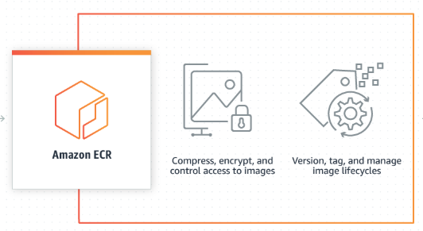
For Today’s Discussion...
Source code repository
Version control for related objects
Container image registry
Service that stores your container images
Repository
Registry
Notes:
collection of related objects could be source files or images that are tagged or numbered
*** Within an image registry you can have repositories of numbered/tagged images
hub.docker.com is the registry
microsoft/aspnetcore is the repository within the docker hub registry
microsoft/aspnetcore/latest is the specific container image within the repository

Slide 7
History

Slide 8
190 Million
October 2007
Microsoft
100 Million
40 Million
Notes:
October 2007 - year github started
100 Million – the number of repositories when I first gave this presentation in Nov 2019
190 Million – repositories hosted on github
40 Million – people use github
Microsoft – owns github

Slide 9

Software Development Lifecycle
Multiple developers working on a project
Project source code is maintained in a repository
Developers work both independently and collaboratively
Merge your changes along with everyone else
Builds occur out of the common branch
Need for:
File Locking
Versioning
Labels, Tags

Slide 10
Traditional Version Control Software
Client-Server model
On-premise
Developers use a shared, single repository
RCS – Revision Control System
SCCS – Source Code Control System
IBM Rational ClearCase
Microsoft Visual SourceSafe
CVS – Concurrent Versions System
Attributes
Examples
Notes:
Traditional version control software is an on-premise client-server application. Generally, has one or more administrators to take care of branching, merging, etc

Slide 11
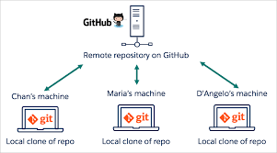
Modern Source Control
SaaS based tools
Distributed version control system
Developer centric tools
Lightweight for agile development
Optimized for local development
Branches are lightweight and cheap

Slide 12
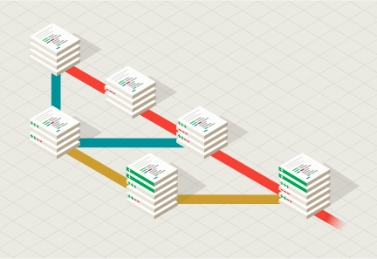
GIT
GIT – an offensive English slang term for “a stupid person”
Created in 2005 by Linus Torvalds (who also developed Linux)
Free open-source software that handles source code versioning
Track local file changes
Share changes with a remote repository
Most widely used modern version control system
https://git-scm.com/

Slide 13
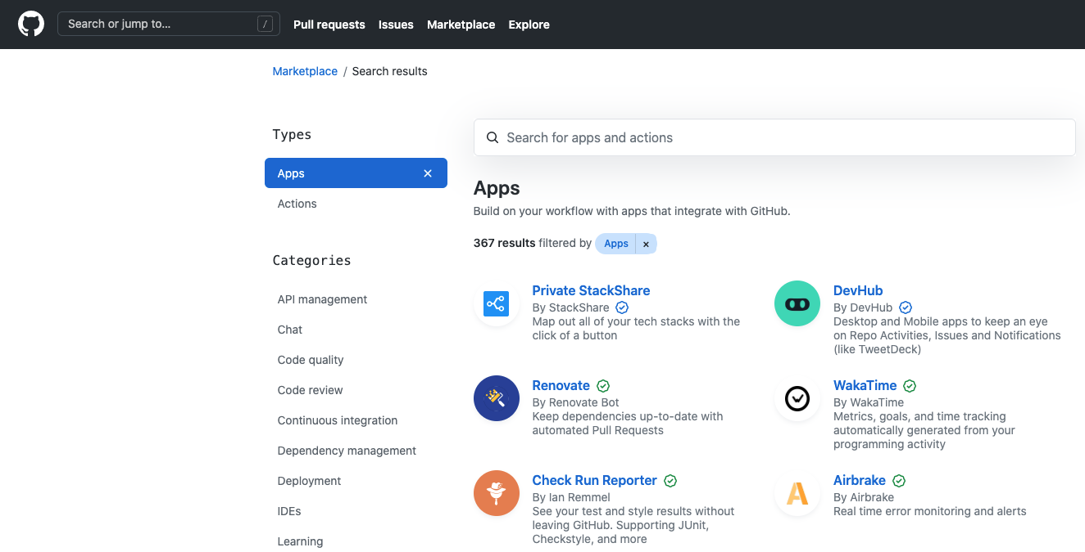
GitHub
Web-based GIT repository for projects
Cloud service for remote hosting of git repositories
Helps manage software development projects
Free services for open source projects
Paid services for private projects
Handles bug tracking, feature requests, task management, wiki's, etc
https://github.com

Slide 14
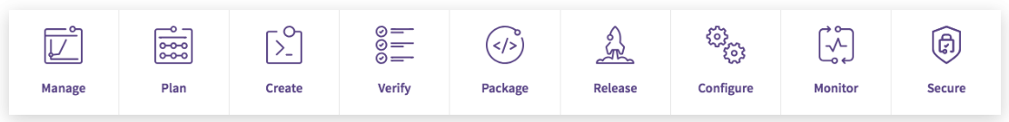
Gitlab
Web-based git repository
Cloud service for public projects
Paid service for private projects
Good at managing the DevOps lifecycle with tools such as Jira, CI runner, release mgmt
Popular due to seamless integration with CI/CD (Continuous Integration) technologies
“Top-of-the-line kitchen for making software”
https://gitlab.com

Slide 15
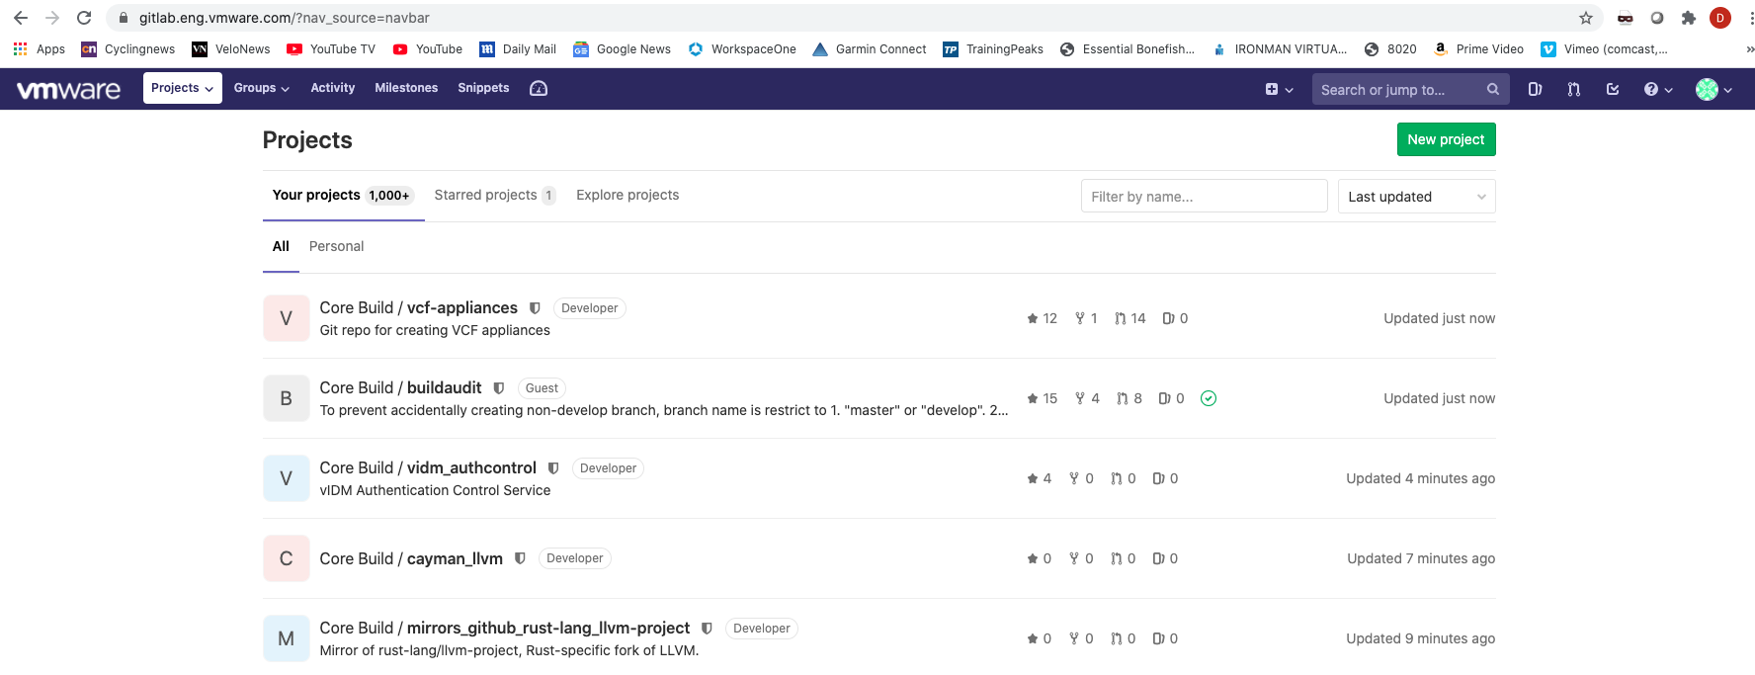
Gitlab at VMware
VMware uses GitLab and has a corporate account
Gitlab.eng.vmware.com
We will be using gitlab internal for our learning

Slide 16
Bitbucket
Web-based version control repository
Uses Git or Mercurial revision control systems
Per-user pricing
On-premise hosting with Bitbucket Data Center
CI/CD integration
www.bitbucket.org

Slide 17
Basic Commands

Slide 18
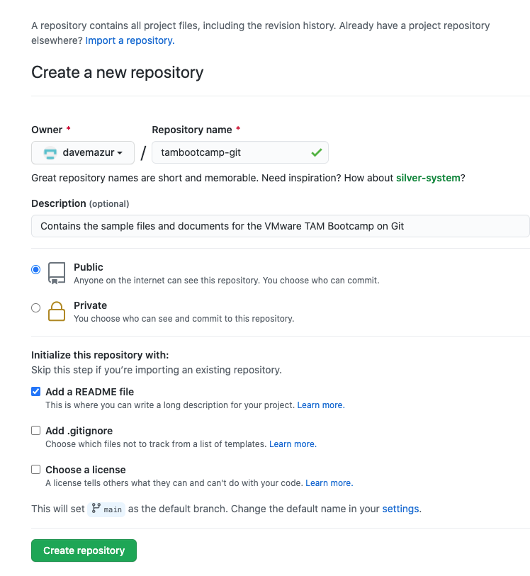
Create a GitHub Repository

Slide 19

Add/Commit/Push
ADD
COMMIT
PUSH
Notes:
After clone, these are the three primary commands when using git. Let’s get into an example.

Slide 20
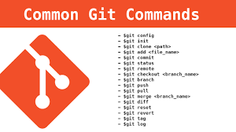
Core Commands
Basic commands you use every day
Git clone username@host:/path/to/repository
Copy a repository
Git add
Add files to the staging area
Git commit
Create a snapshot of the changes and save it to the git directory
Git push
Send local commits to the master branch of the remote repository
Git pull
Merge all changes present in the remote repository to the local working directory
Git restore
Restore a previous version of a file from the repository
Git status
Displays the list of changed files together with the files that are yet to be staged or committed
Git help
Command line help

Slide 21
Other Commands
Git init
Create a new local GIT repository
Git remote
View all remote repositories
Git checkout
Creates branches and helps you to navigate between them
Git fork
A copy of a repository
Git branch
List, create, or delete branches

Slide 22
Advanced Topics

Slide 23
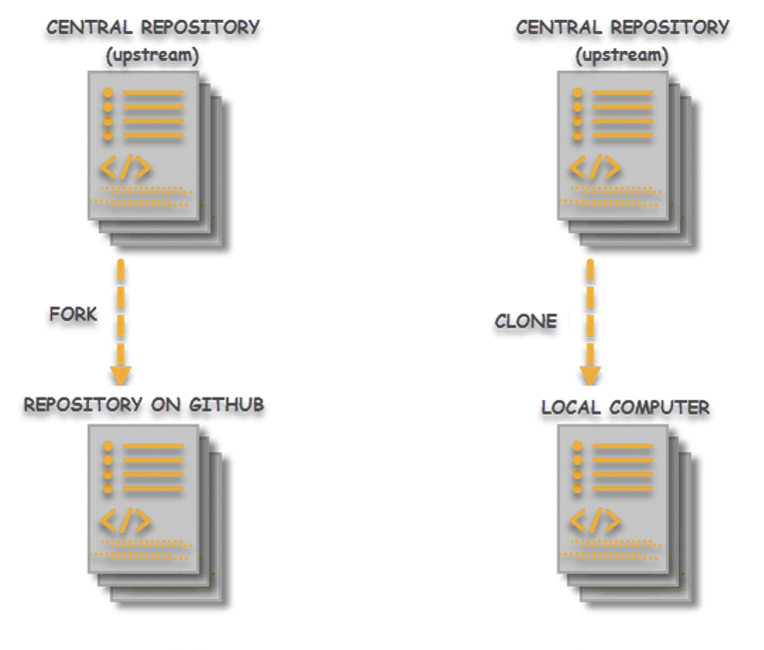
Git Clone vs Git Fork
CLONE
FORK
- Creates a local copy of a repository
- Takes the repository and puts it into a folder with the name of the repository
- Gets changes made by the parent via pull/rebase
- Allows easy push and merge with parent
- Creates a new repository with the “forked” code
- You then clone from the fork
- Does not get any changes made by the parent,
- AWS fork of ElasticSearch/Kibana is an example
https://aws.amazon.com/blogs/opensource/stepping-up-for-a-truly-open-source-elasticsearch/
Notes:
Provide the example of AWS forking elasticsearch recently and a link to the article
AWS chose to fork the previous opensource version of ElasticSearch and Kibana. AWS will maintain the source repository and manage code changes.
Example:
Show a clone
Have someone make a change in the parent
Git pull to get the change
Fork the repository
Git clone of the new repository

Slide 24
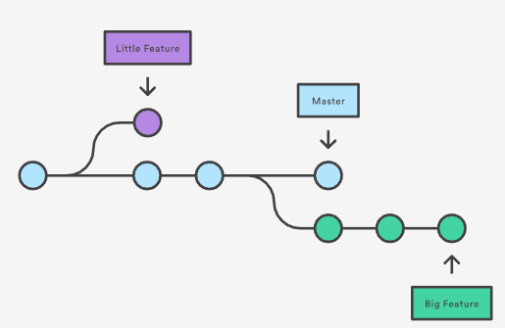
Branches
- Branches are part of the development process
- You create a branch when fixing a bug or adding a feature
- A branch represents an independent line of development
- git branch works on local and remote branches
- git checkout allows you to create and switch to a branch
Notes:
Show simple branches by multiple developers off master
Branch off master into v2, make changes, merge into v2 branch, then merge v2 into master

Slide 25
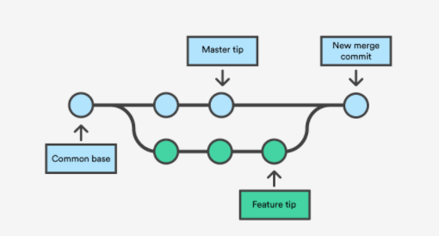
Merging
- takes a branch and merges changes with the parent
- git shows you both versions (branch and parent) and lets you decide which changes/conflicts to accept
Notes:
Example

Slide 26
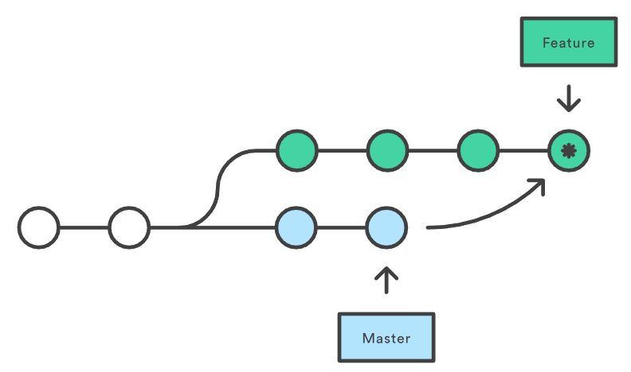
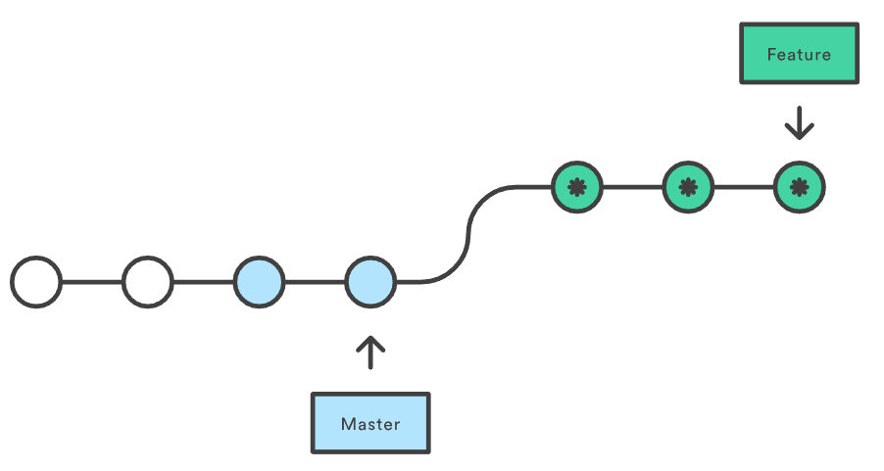
Git Pull vs Git Rebase
PULL
REBASE
- Fetches the latest changes of the current branch
- Applies those changes to your local copy
- Local changes are “merged” with the remote changes
- Same as git fetch/git merge
- Non-destructive (existing branches are not changed in any way
- Combines two branches
- Moves one branch on top of the other
- Moves all changes in ”feature” branch into the “main” branch
- You lose project history
https://www.atlassian.com/git/tutorials/merging-vs-rebasing
Notes:
Example:
No idea how to show this one...

Slide 27
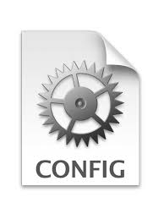
Git Profiles
Git comes with a config tool
Generally, config is stored in $HOME/.gitconfig
Can be used with the % git config command
Use to set your identity
Use to identify your “ignore” file
Things you can set in your profile
Default branch
Colors
Editor
https://git-scm.com/docs/git-config
% more .gitconfig
# This is Git's per-user configuration file.
[user]
name = Dave Mazur
email = davemazur@comcast.net
[core]
excludesfile = /Users/dmazur/.gitignore_global

Slide 28
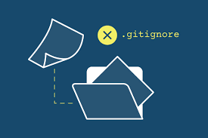
Git Ignore
Specifies intentionally untracked files to ignore
Each line specifies a pattern
Helps make sure you do not push
Credentials
Log files
Generally, resides in your $HOME directory
Can be specified in your .gitprofile
Create one of these as a “best practice”
https://git-scm.com/docs/gitignore
% more .gitignore_global
*~
.*.swp
.DS_Store
**/_output/*
**/credentials-minio/*

Slide 29
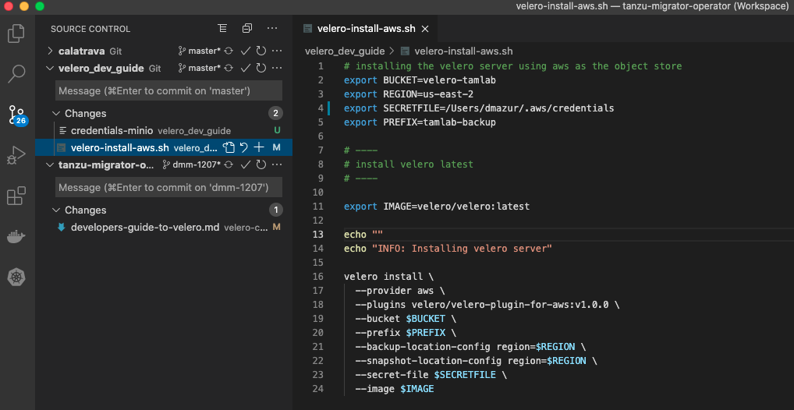
Microsoft Visual Studio Code
Visual Studio Code
IDE (Integrated Development Environment)
Integrated source control
Plugins for
Git
Docker
Kubernetes
Markdown
JSON
Yaml
Allows you to perform Git actions from the IDE
Notes:
Visual Studio Code is an integrated development environment from Microsoft (free btw). Had good integration with git.
It recognizes the .git file in the development subdirectory and updates the environment as files are modified.
You can still use the command line and changes are reflected in vs code

Slide 30
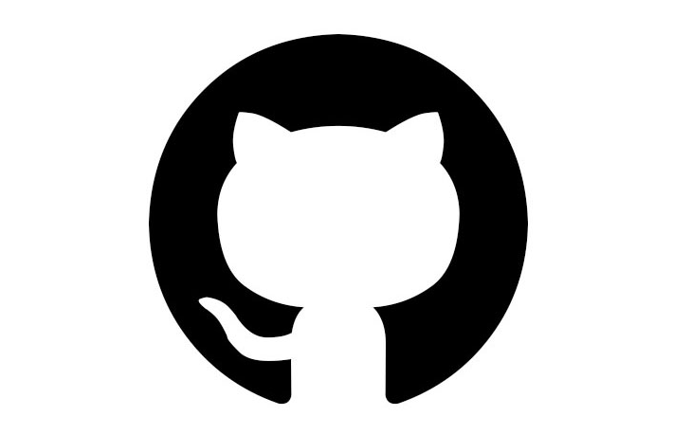
Additional Resources
Git Cheat Sheet
https://training.github.com/
Git Command Reference
https://git-scm.com/docs
Git Training
https://githubtraining.github.io/training-manual/#/02_getting_started
https://www.atlassian.com/git/tutorials/learn-git-with-bitbucket-cloud

Slide 31
Modern Registries

Slide 32
Docker Hub
Create, manage and deliver container images
World’s largest community for container images
Integration with the development pipeline
100,000+ container images
https://hub.docker.com/
Notes:
A registry is a collection of repositories
A repository is a collection of images

Slide 33
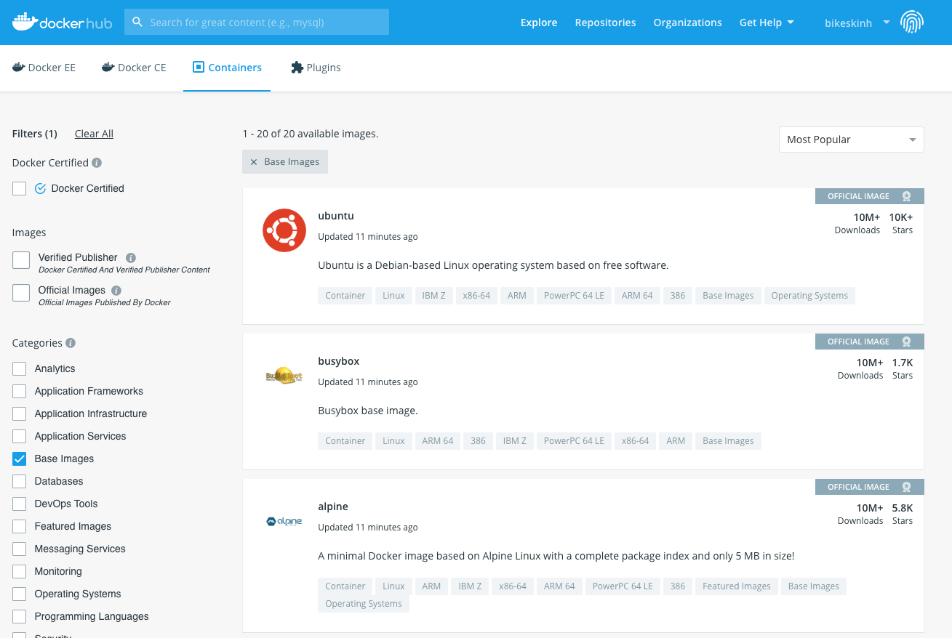
Docker Hub Examples

Slide 34
The Big Three
Amazon ECR
Google Container Registry
Azure Container Registry
Fully-manages Docker container registry
Store, manage and deploy Docker container images
Integrated with ECS (Elastic Container Service)
Highly available, highly scalable
Pay for the amount of data you store in your repository
Secure, private docker registry on GCP
Integration with github
Regional private repositories on GCP
Native Docker support
Extensible architecture for CI/CD
Build, store, secure, scan and manage container images
Supports Docker, Azure Kubernetes Service and RedHat OpenShift
Geo-replication

Slide 35
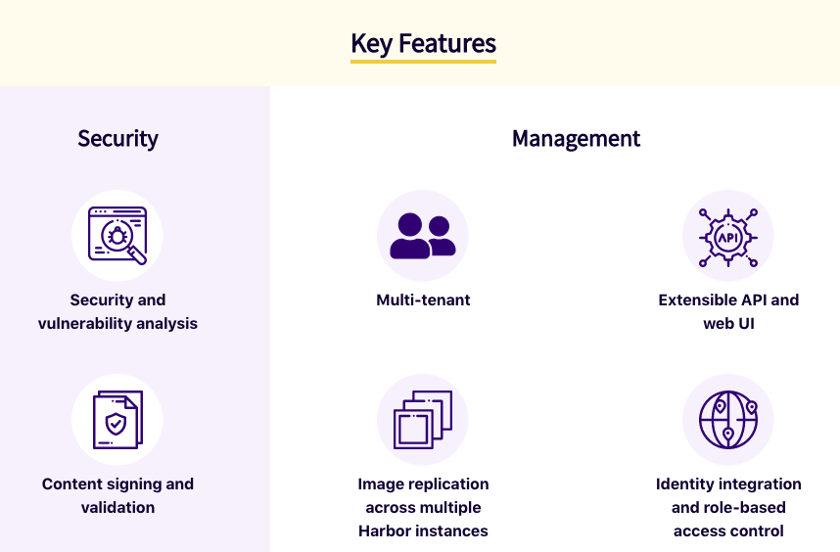
Harbor
Open source container image registry
Started by VMware in 2014
Role-based access control
Included as part of all Tanzu releases
Replication of images across registries
REST API
https://goharbor.io/

Slide 36
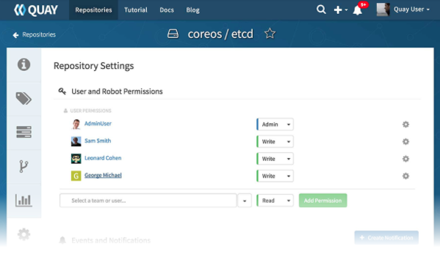
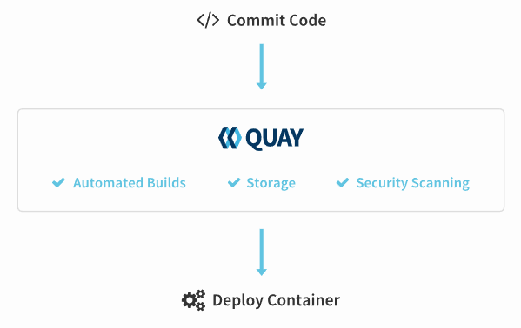
Quay / Quay.io
Container registry
Founded in 2012
Sold and hosted by Red Hat
Hosted in cloud or on-prem
Integration with GitHub, Gitlab, BitBucket
Quay – Red Hat’s on-prem registry
Quay.io - Red Hat’s hosted service registry
Projectquay.io is the opensource distribution that powers Red Hat Quay and Quay.io

Slide 37
LAB

